Slide 1
L:H Preliminary
20220426

Slide 2
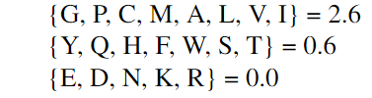
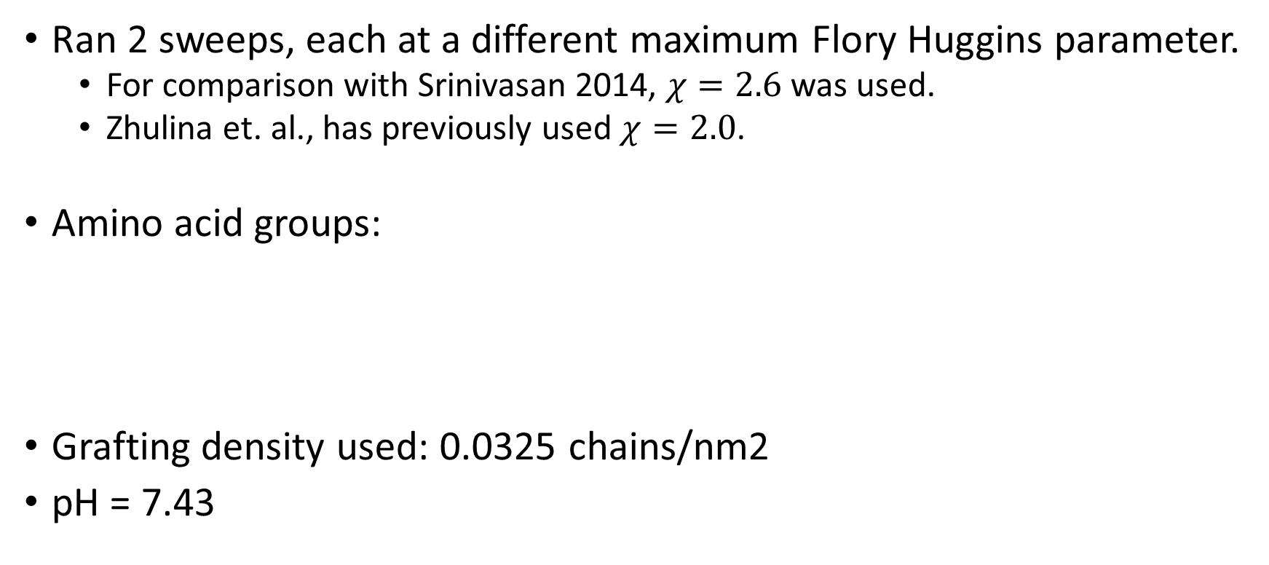
Outline
Ran 2 sweeps, each at a different maximum Flory Huggins parameter.
For comparison with Srinivasan 2014, $χ=2.6$ was used.
Zhulina et. al., has previously used $χ=2.0$.
Amino acid groups:
Grafting density used: 0.0325 chains/nm2
pH = 7.43
2.6 (Sweep 1) or 2.0 (Sweep 2)

Slide 3
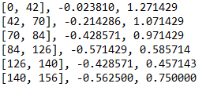
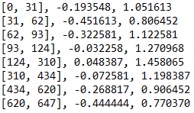
Sweep 1: Same Flory Huggins as previous project (Comparing with Srinivasan 2014)
Charge distribution fixed after comparing pH of buffer to pKa of each ionizable group
NFL
NFH
N
Charge
Flory Huggins
N
Charge
Flory Huggins

Slide 4
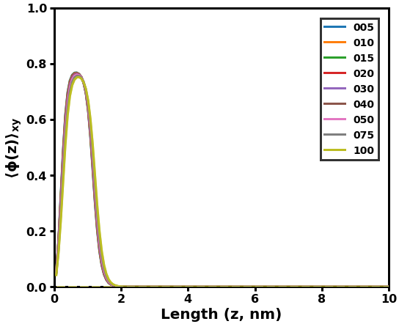
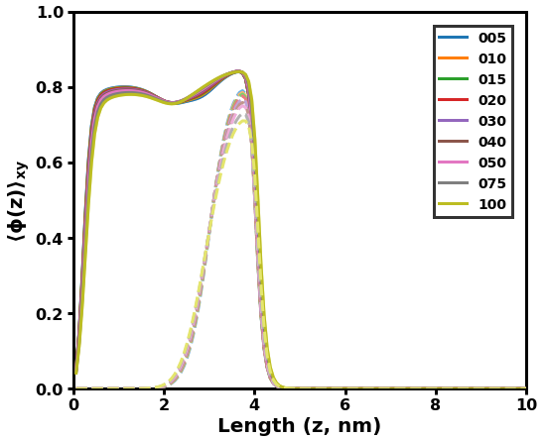
Ionic strength (including H from pH = 7),
[5, 10, 15, 20, 30, 40, 50, 75, 100] mM
Pure NFL
Pure NFH
Comments: Interesting semi-bimodal conformation of NFH. The outer layer comprised almost purely of the 5th block (dashed), while blocks 1-4 and 6-8 comprise of the inner layer. I need to do more to understand why this is case, since intuitively, the 5th block is the only positively charged block and the most hydrophobic, so I would expect it to be in the middle of the brush.
Neither is very sensitive to salt concentration.

Slide 5
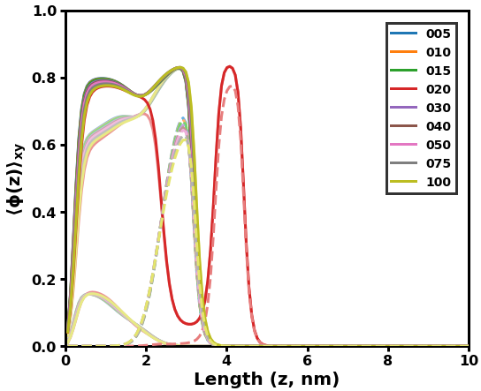
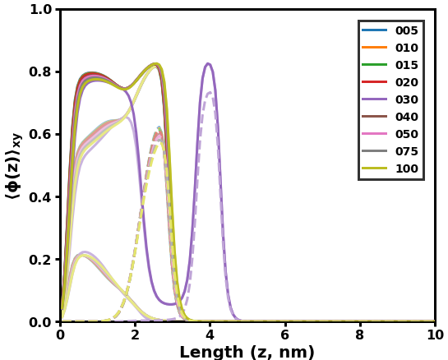
L: 3, H: 7
L: 4, H: 6
NFH
NFH
NFH
NFH
NFL
NFL
Comments: At some ionic strengths and L/H ratios, completely bimodal distribution appears. 2nd layer is comprised almost entirely of block 5, while all other blocks exist in the 1st layer.
Note: This conformation is similar to one found in my previous project, where the transition between 1 layer and 2 was a first-order phase transition. However, the internal structure of this brush versus the previous is different, as the outer layer is completely comprised of one block instead of some contribution from all.

Slide 6
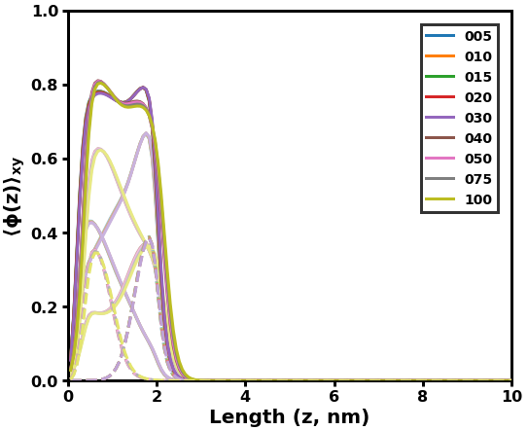
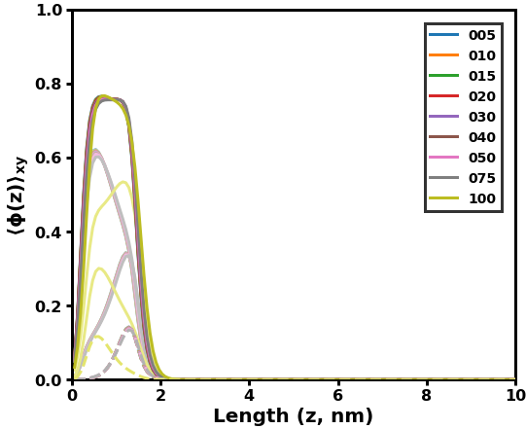
L: 7, H: 3
L: 9, H: 1
NFH
NFL
NFL
NFH
Comments: L and H seem to switch spots (close to surface or solution) as a function of salt concentration. Behavior seems to flip depending on which NFSA has more volume (as a function of chain length and composition).

Slide 7
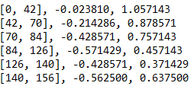
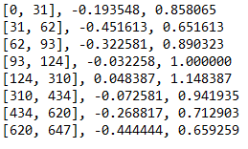
Sweep 2: Same FH as Zhulina, 2007
Charge distribution same as previous, only FH for each block changed
NFL
NFH
N
Charge
Flory Huggins
N
Charge
Flory Huggins

Slide 8
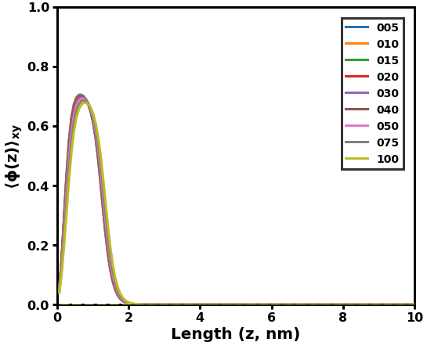
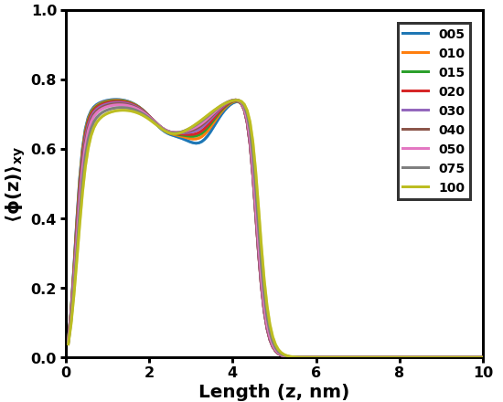
Ionic strength (including H from pH = 7),
[5, 10, 15, 20, 30, 40, 50, 75, 100] mM
Pure NFL
Pure NFH
Comments: Same comments as Sweep 1
Neither is very sensitive to salt concentration.

Slide 9
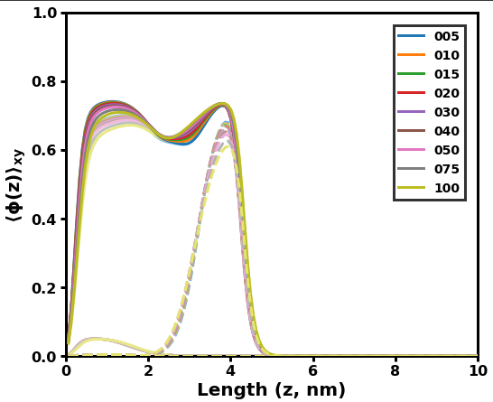
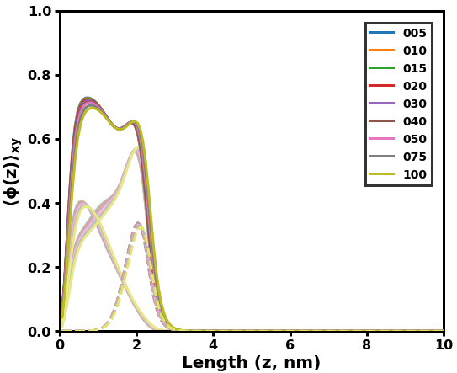
L: 1, H: 9
L: 7, H: 3
NFH
NFH
NFL
Intermediate ratios exhibit similar behavior
NFL
Comments: L = 1 ~ 7 retains overall structure of pure NFH (block 5 of NFH is dashed), with outer layer diminishing as a function of L/H. NFH seems to be reacting to the salt concentration, but only by shifting more into the outer layer and not changing the overall height of the brush

Slide 10
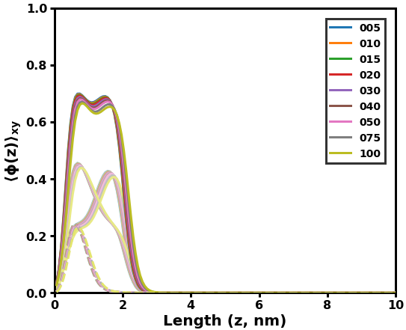
L: 8, H: 2
NFH
NFL
Comments: Block 5 of NFH is now deep inside the brush (closer to what is expected, since it’s positive and hydrophobic)

Slide 11
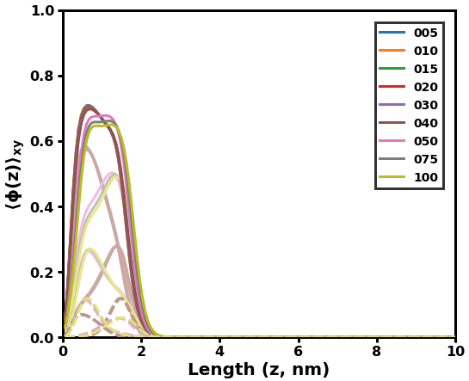
L: 9, H: 1
NFH
NFL
Comments: Somewhere between 40 and 50 mM, NFH goes from being on the inside and NFL on the outside to the opposite.

